Slide 1
Group 10 Project Pitch
January 20th 2021

Slide 2
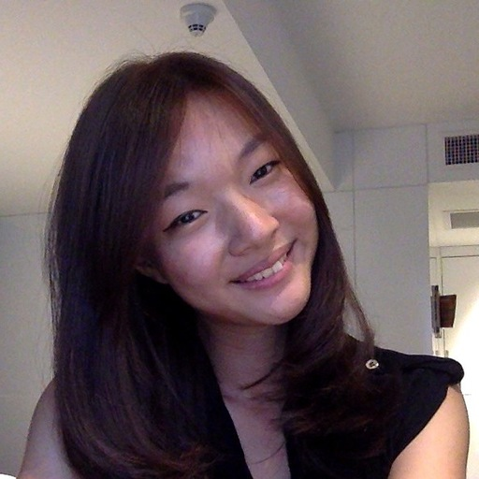
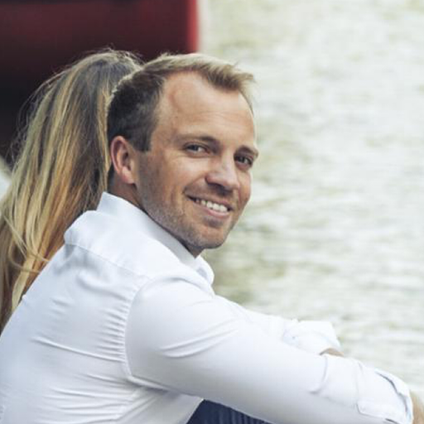
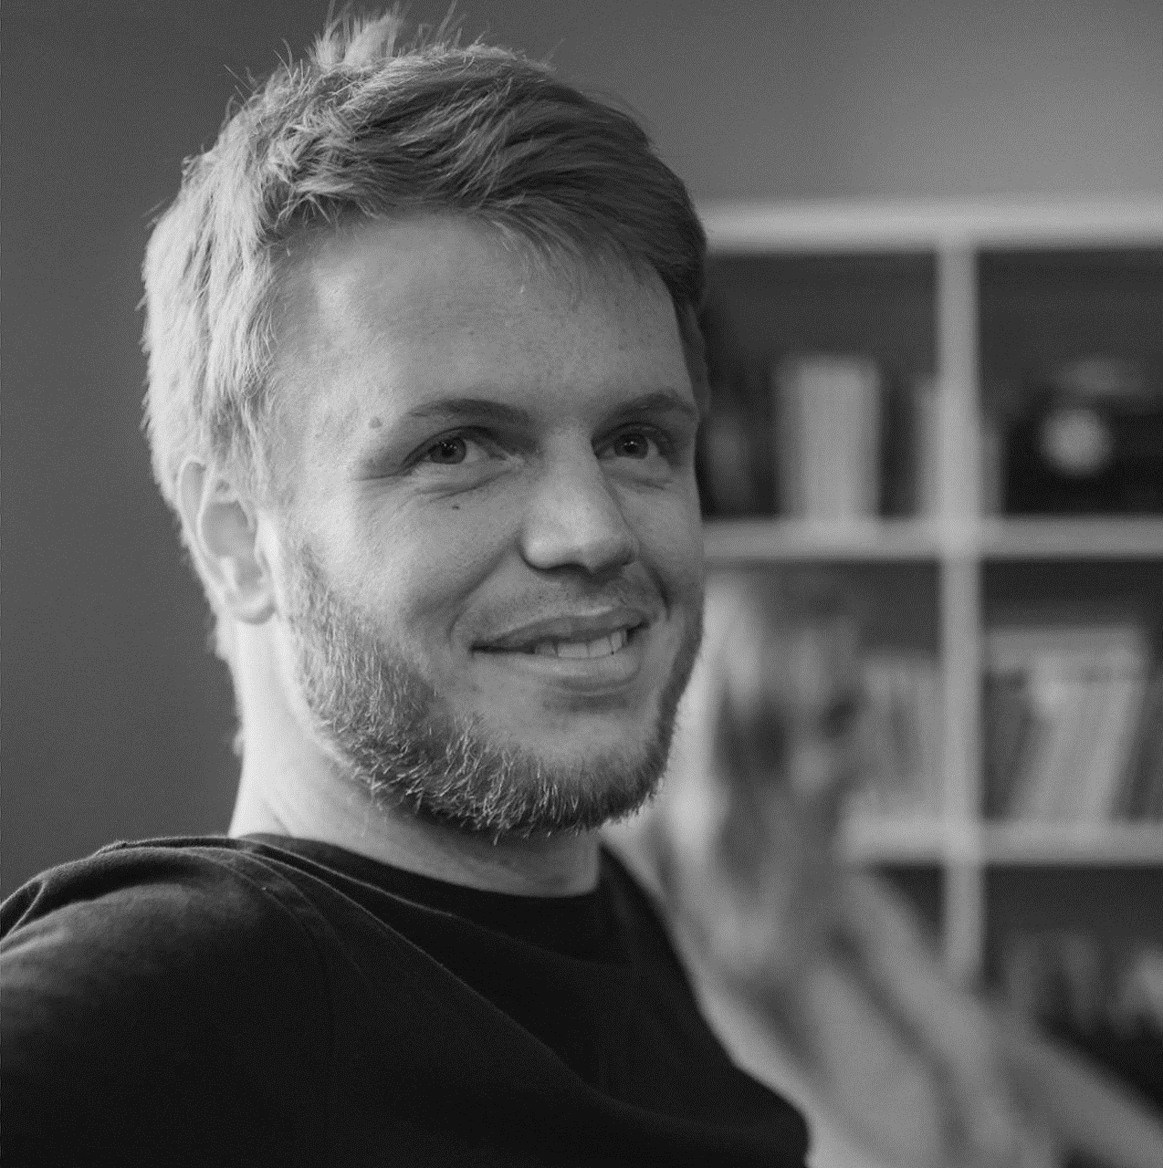
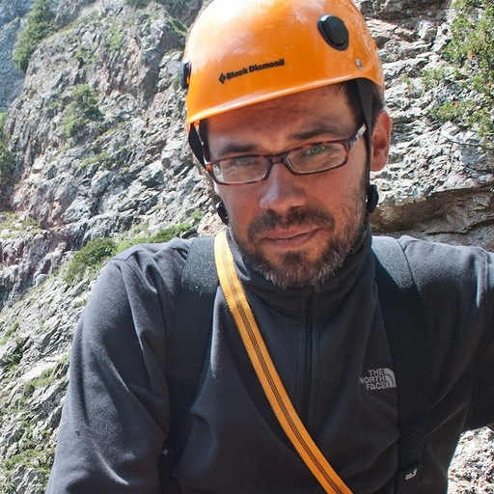
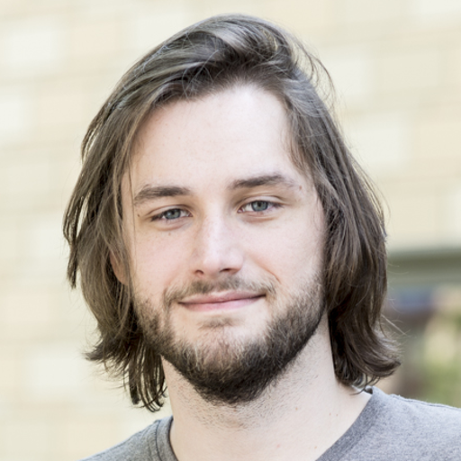
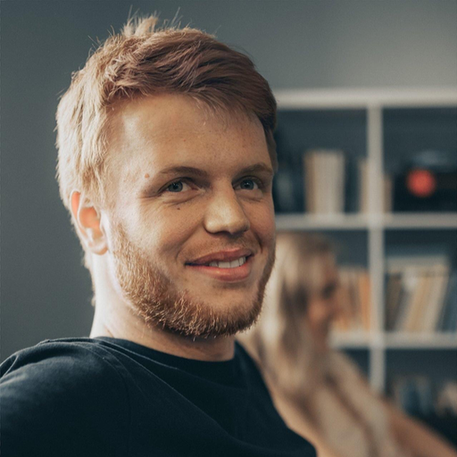
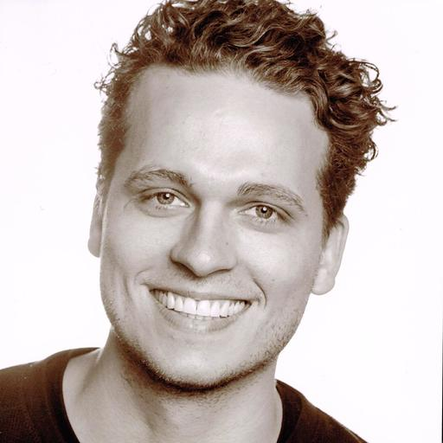
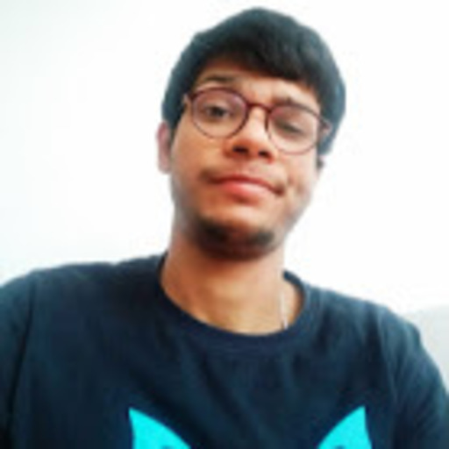
The Team
Adeline
Andreas
Igor
Marco
Johann
Tobias
Papul

Slide 3




Our Project Partner Urban Waters
Founded in Bremen, globally active NGO
Group of Researchers, Planners & practitioners
Focus on ecological potentials of water sources in cities

Slide 4
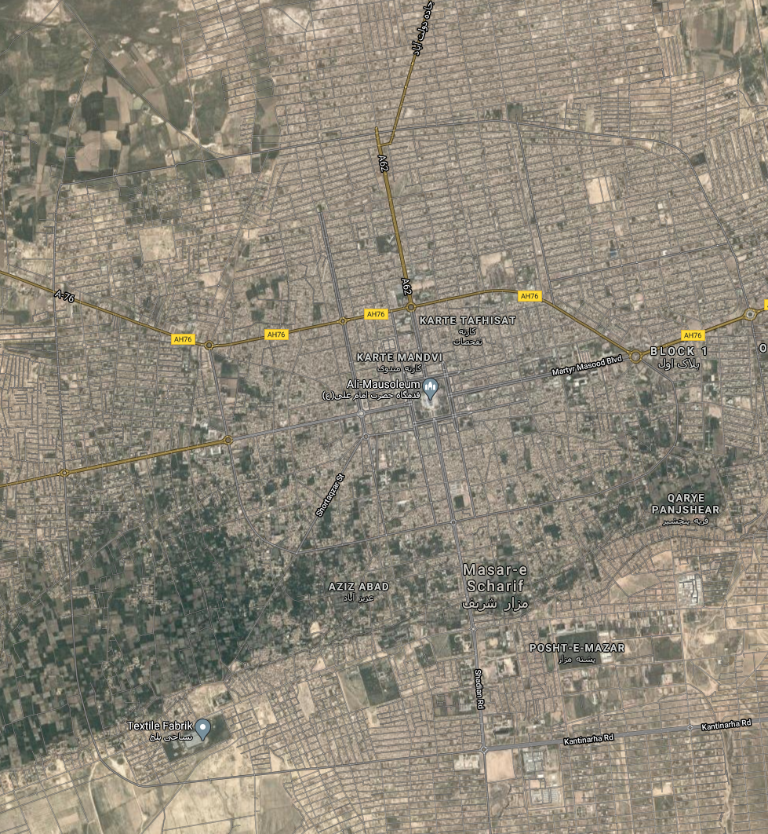
The Project
Overall Goal of Urban Waters project:
Minimizing operational cost for the sewage process (eg. in Mazar-e-Sharif, Afghanistan)
Where to build new sewage plants?
Our task
Write a code to calculate the center points of all city (sub)districts
Automate the calculations of distance and time from given point(sewage plant)

Slide 5
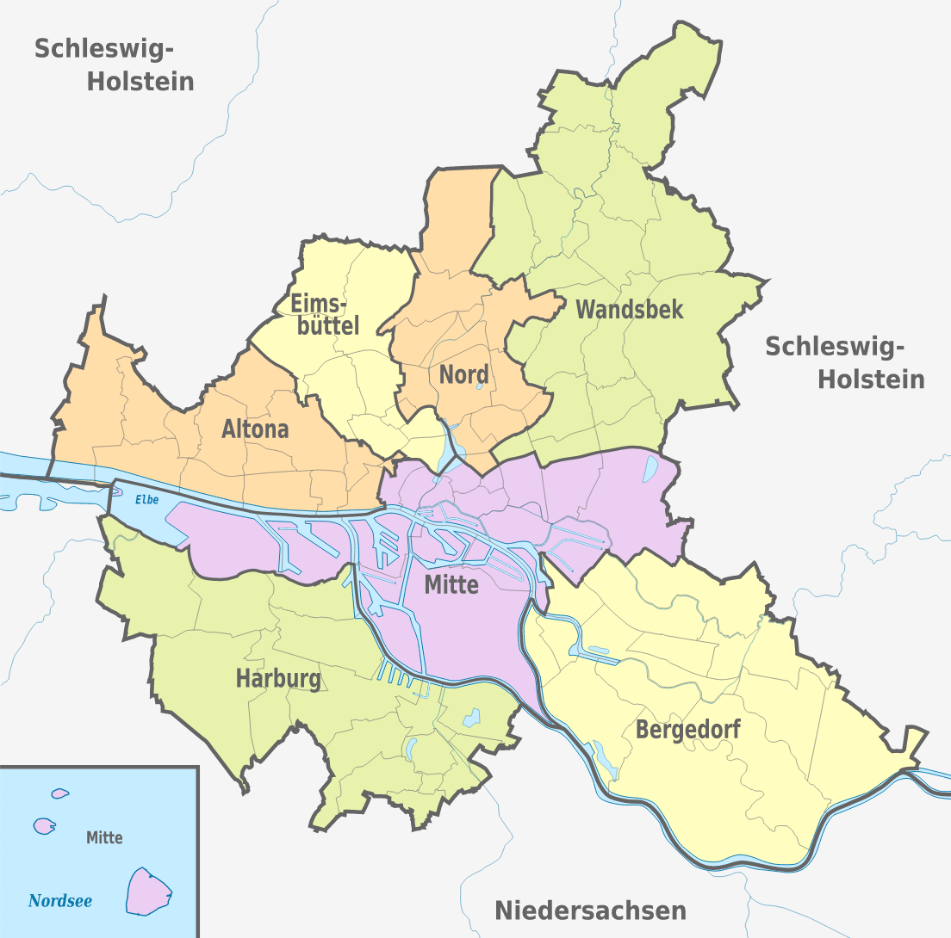
Example: Hamburg Administrative Districts

Slide 6
The Plan
Importing geographic Data to Python
Developing code to calculate center points of polygons (districts)
Applying the code to the geographic Data of Masar-e Scharif
January 2021
March 2021

